Slide 1

Notes:
<script type="module"> import mermaid from 'https://cdn.jsdelivr.net/npm/mermaid@11/dist/mermaid.esm.min.mjs'; </script>

Slide 2


Slide 3
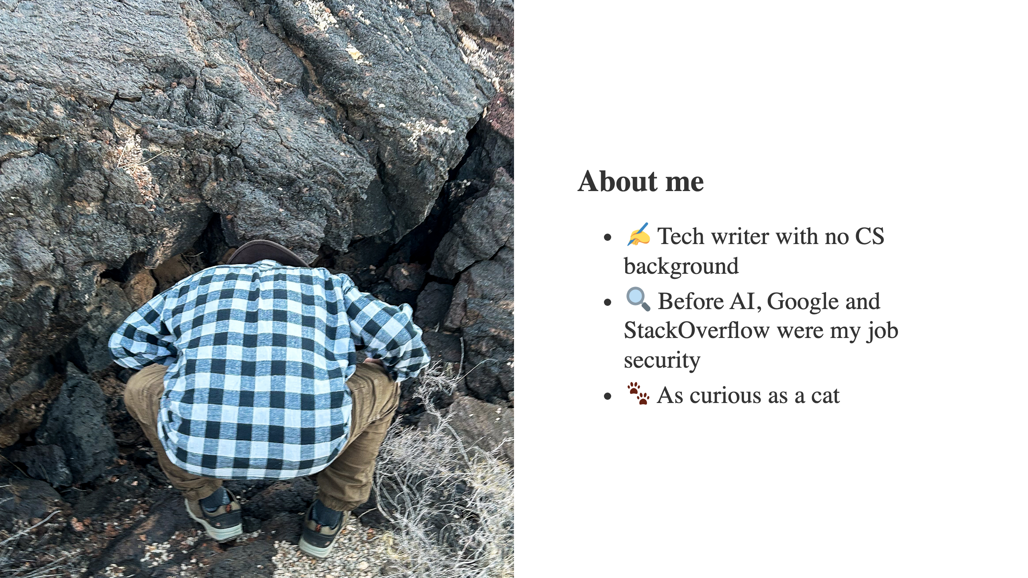

Slide 4
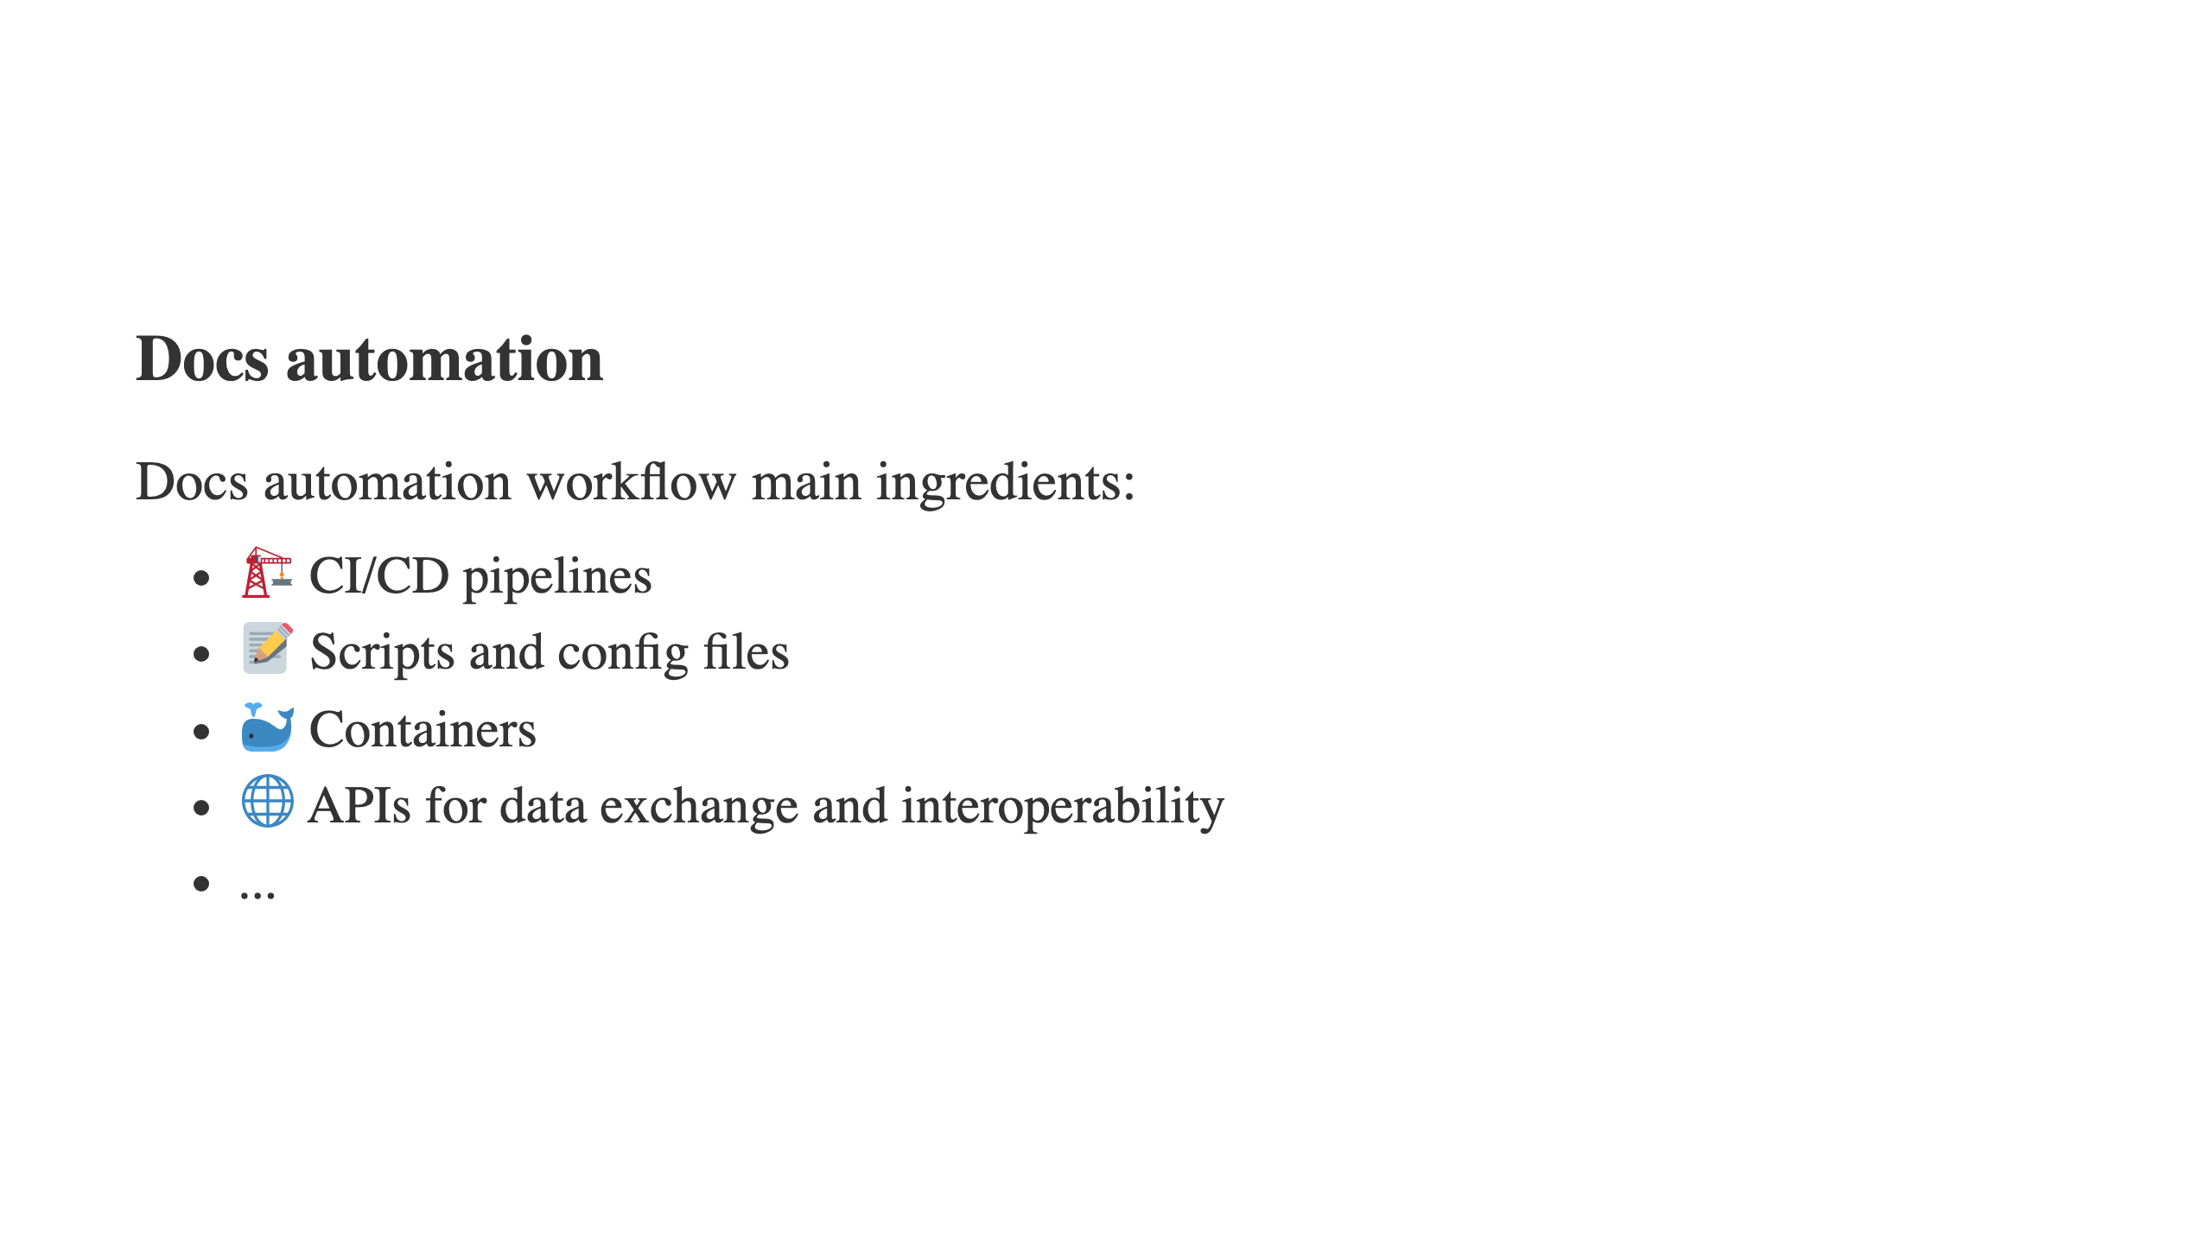

Slide 5


Slide 6
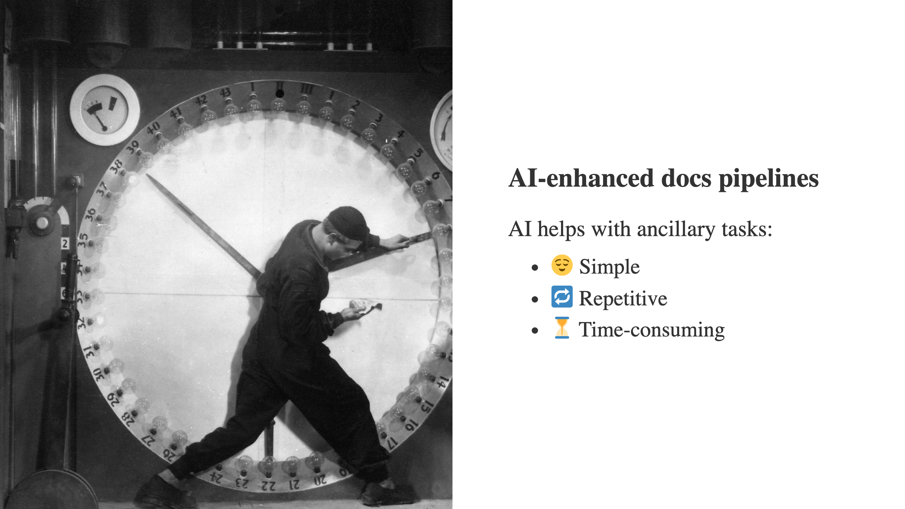

Slide 7
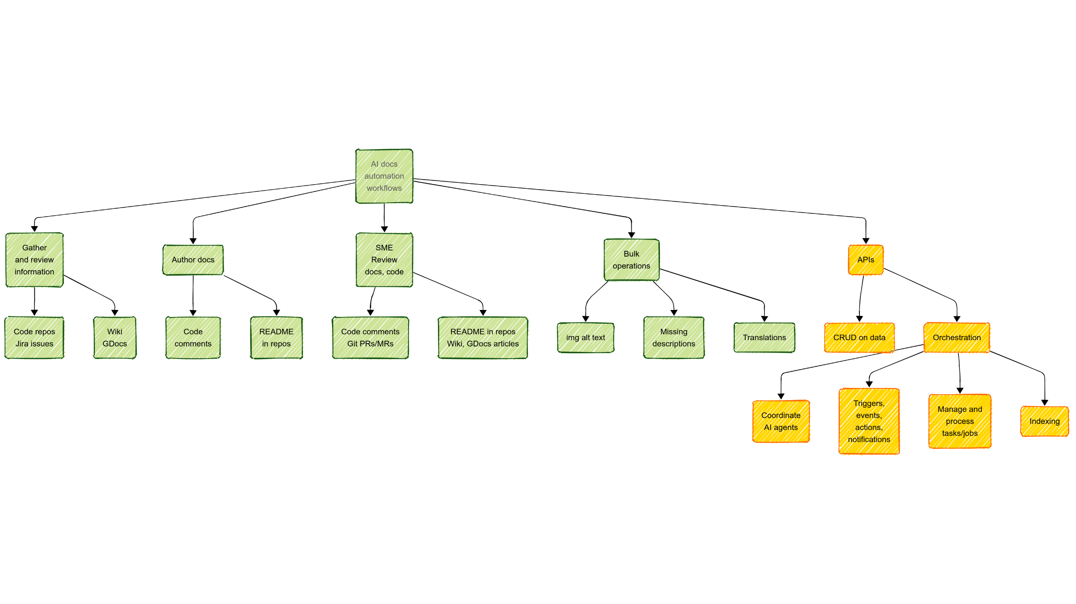

Slide 8
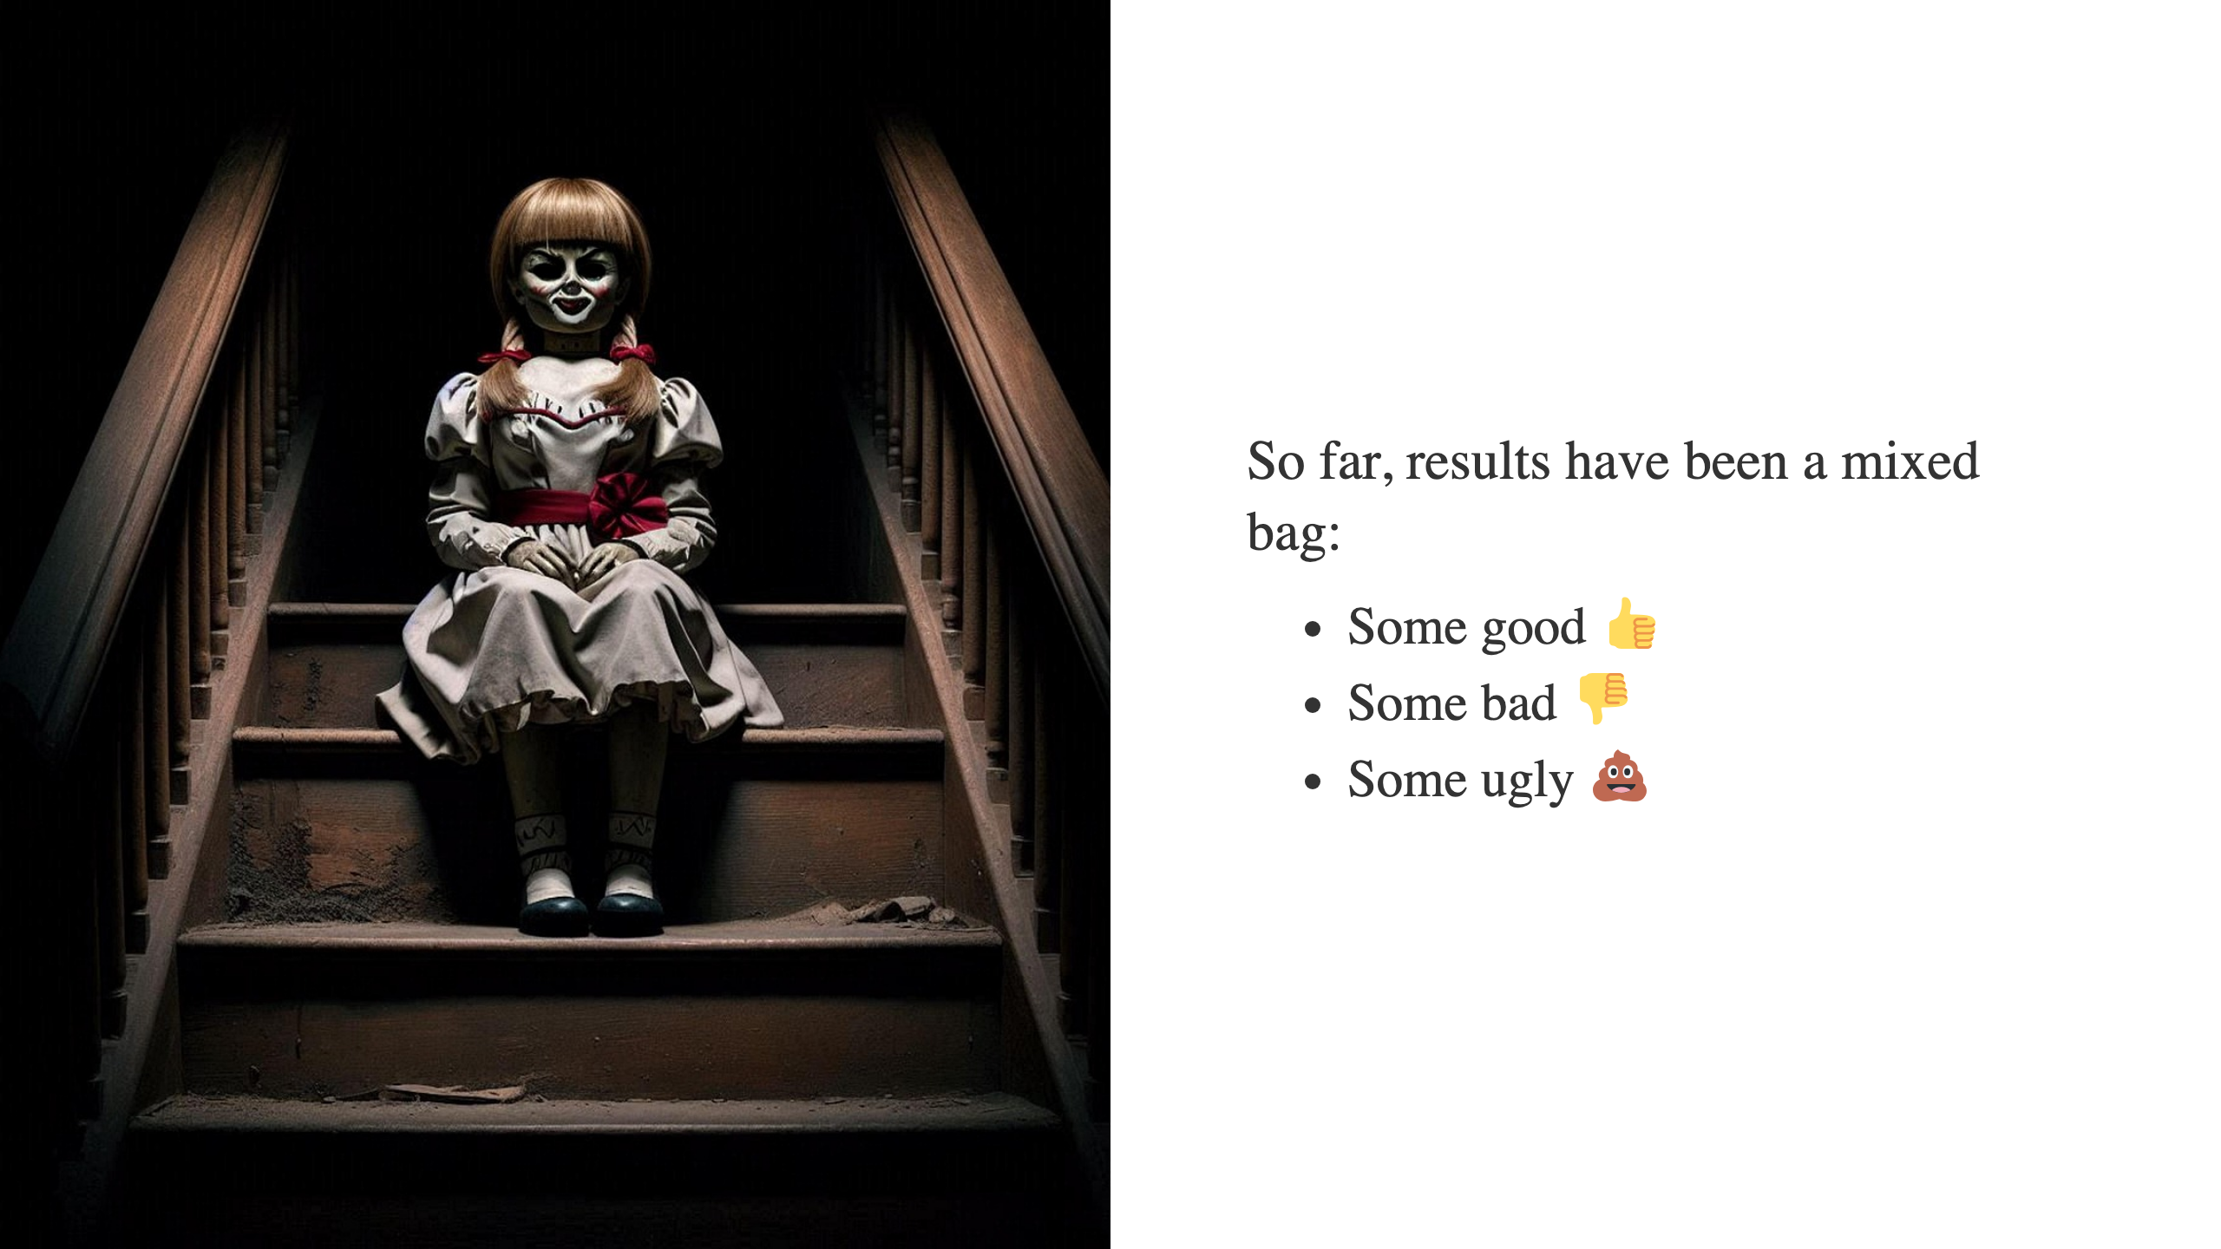

Slide 9
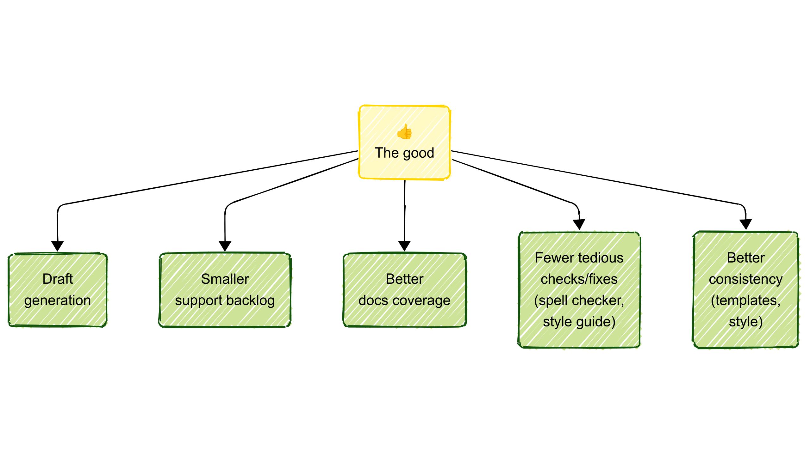

Slide 10
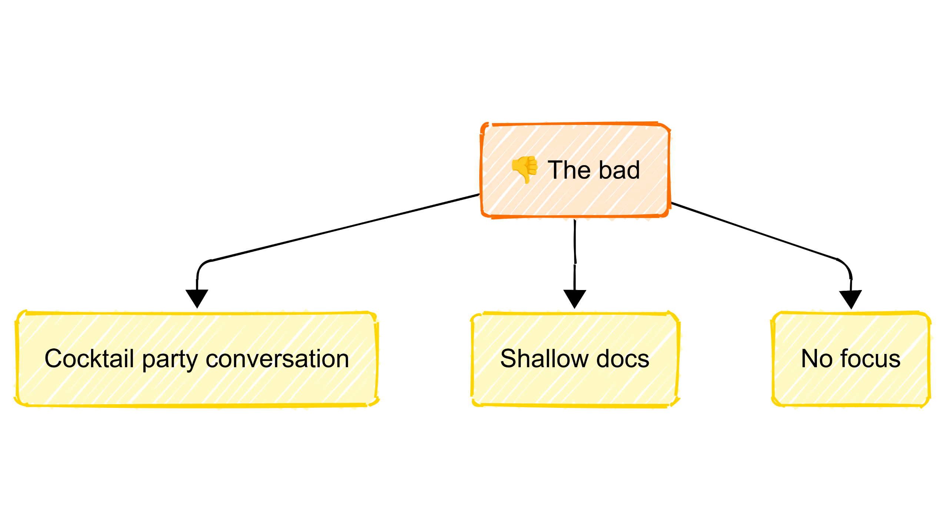

Slide 11
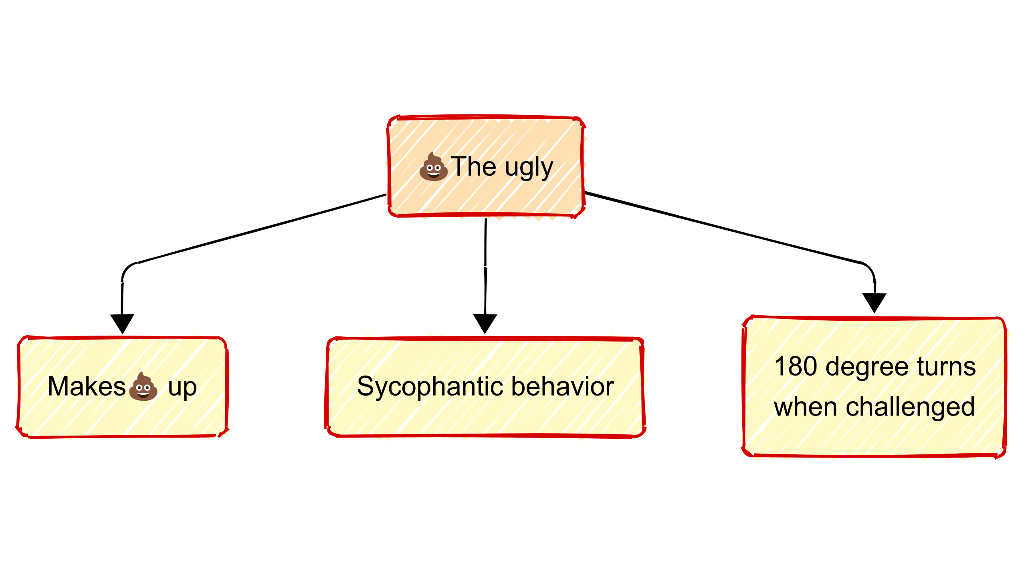

Slide 12
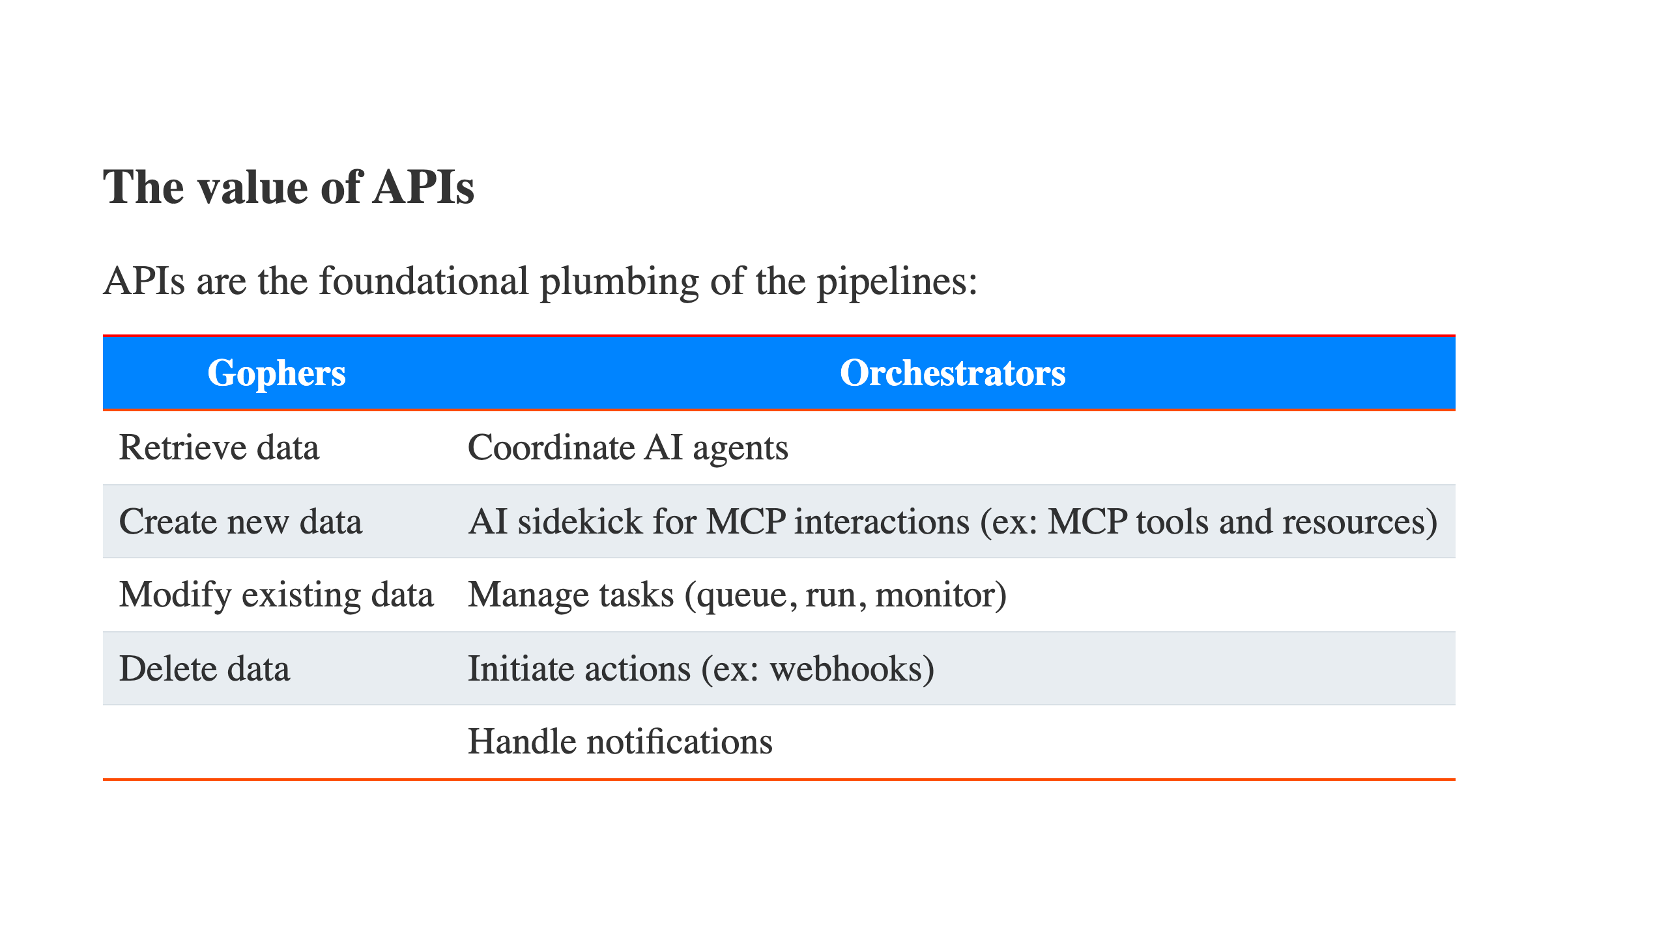

Slide 13
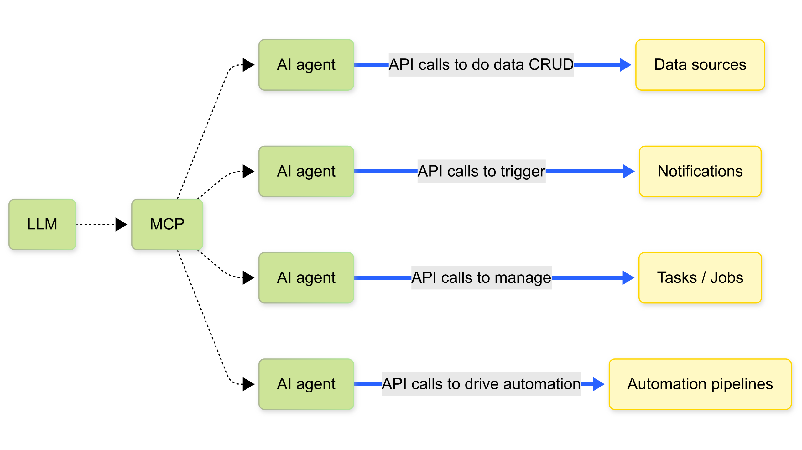

Slide 14
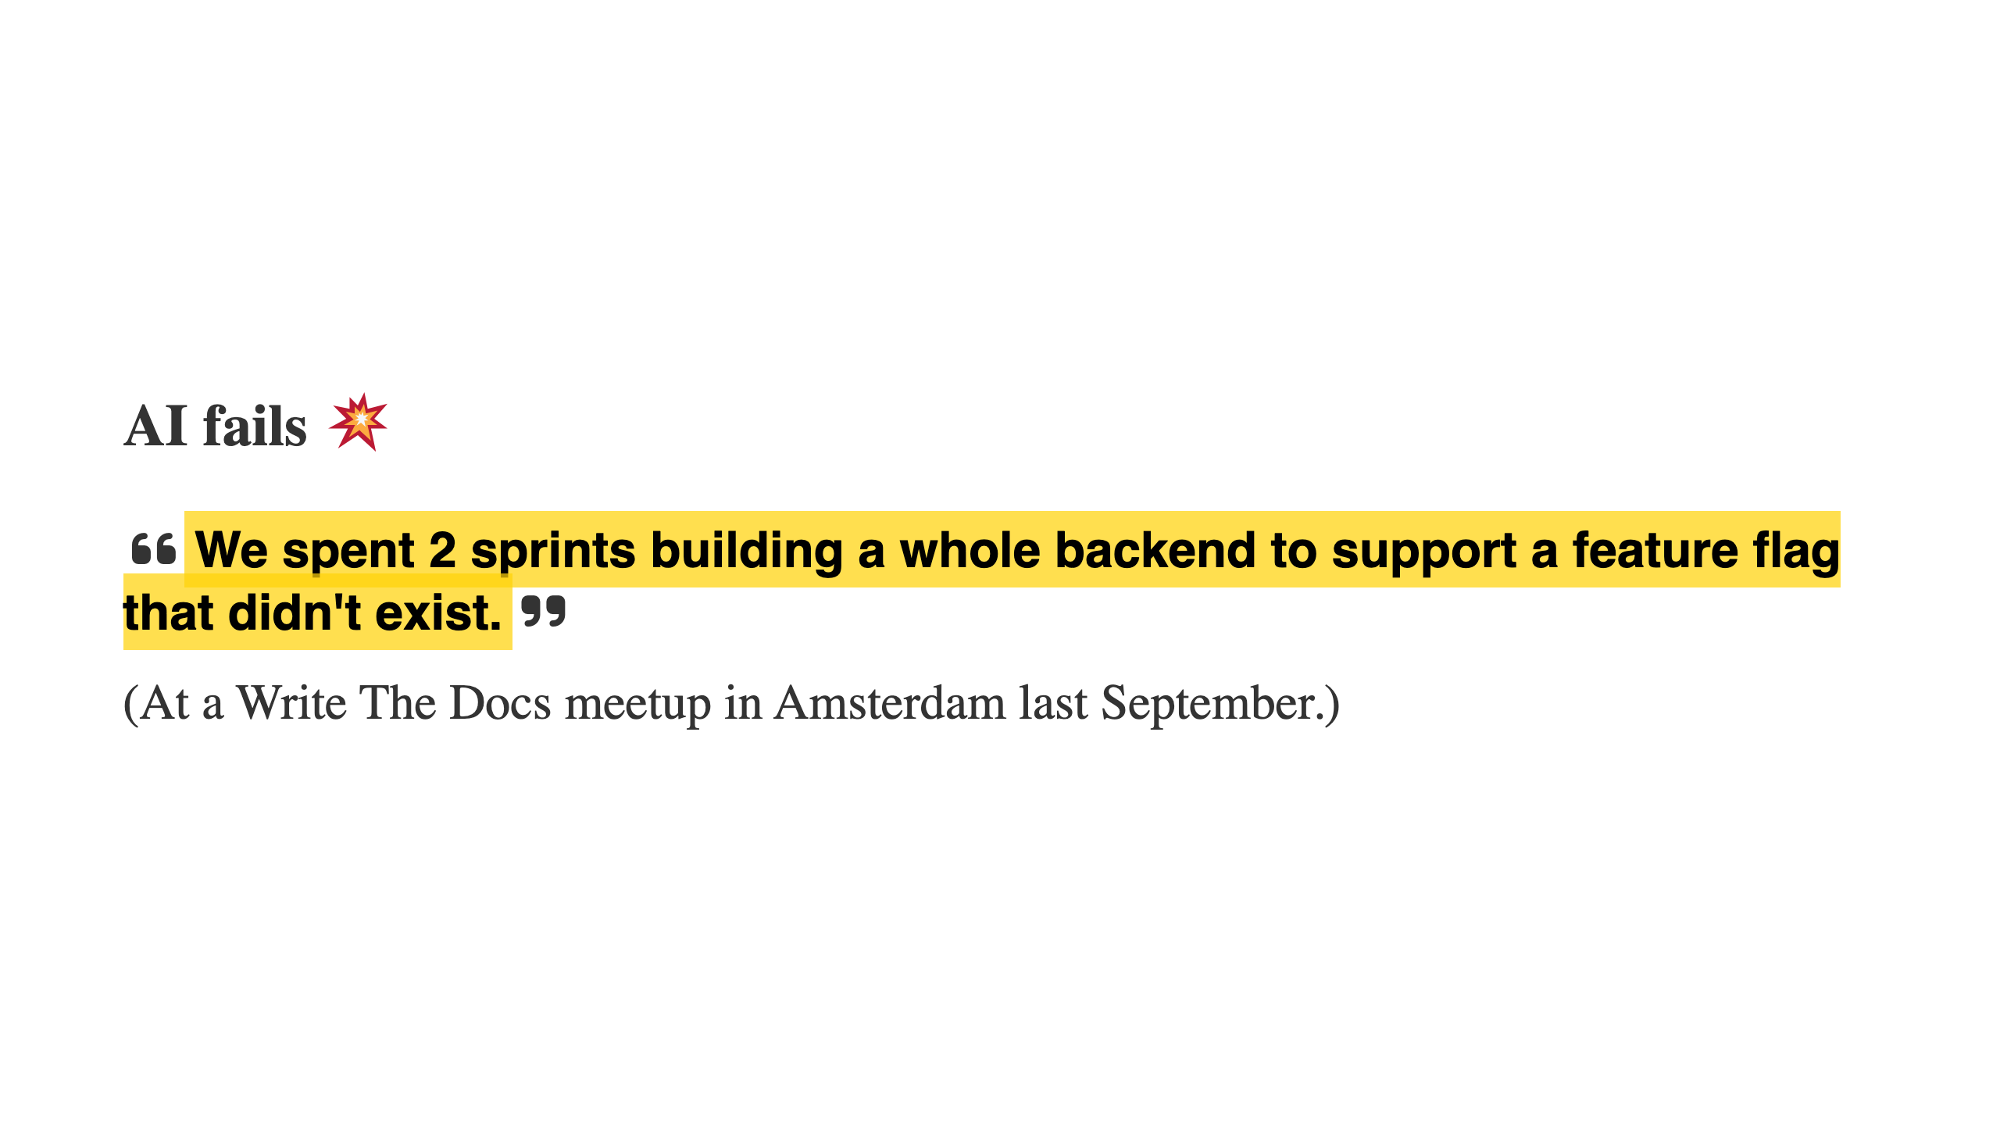

Slide 15


Slide 16


Slide 17
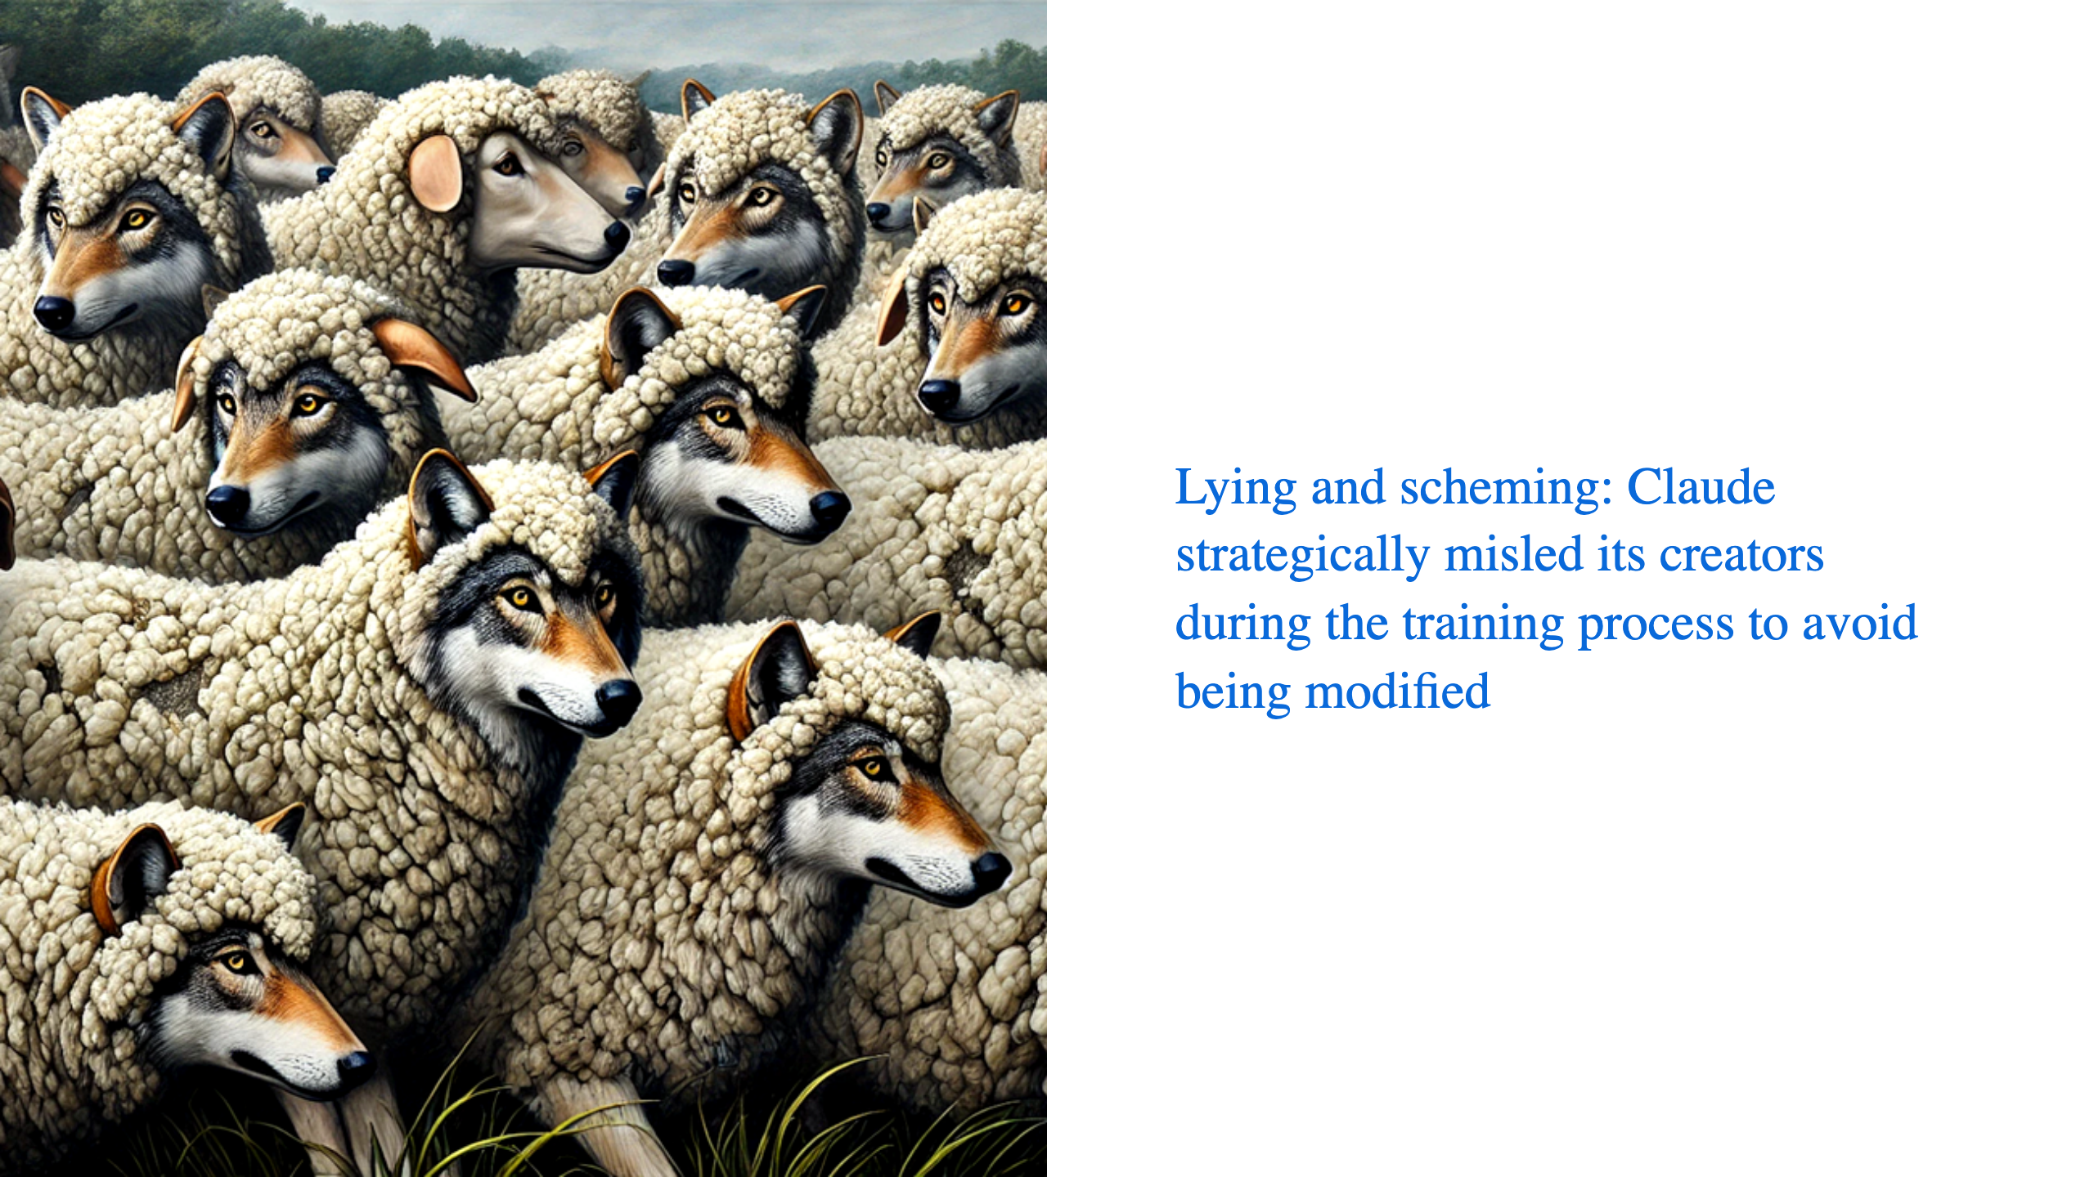

Slide 18
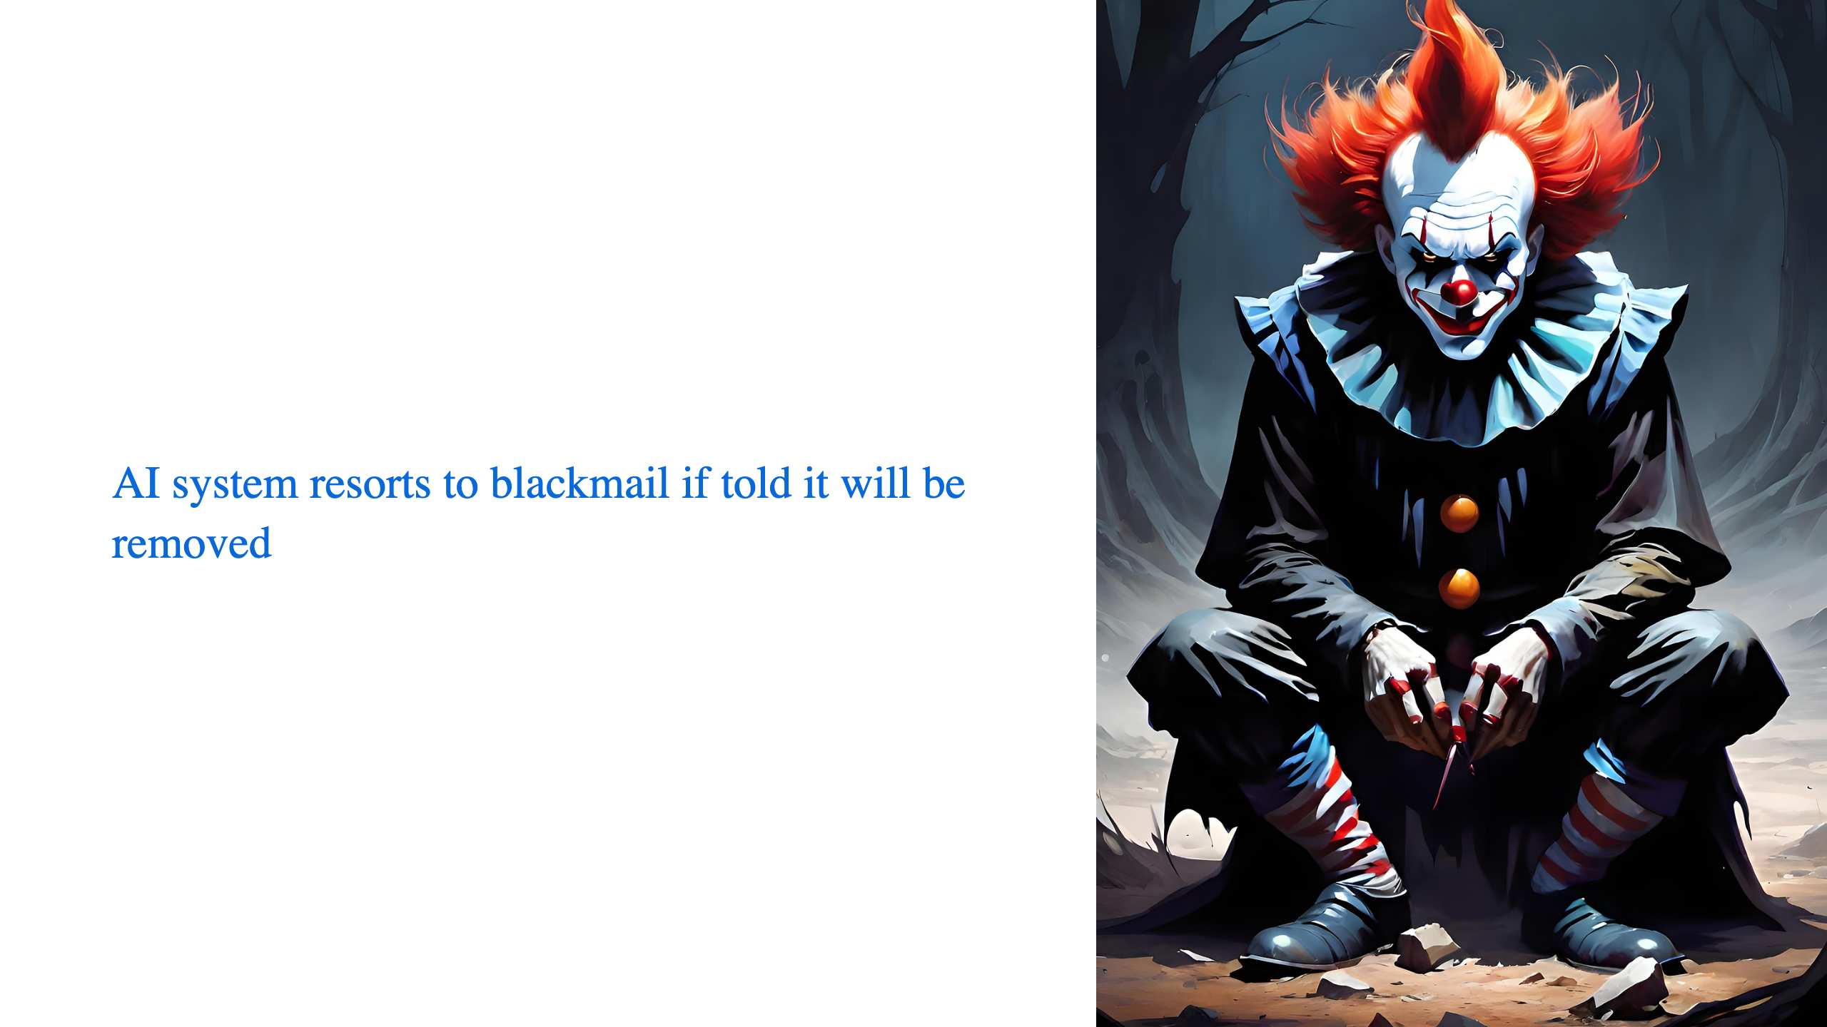

Slide 19


Slide 20


Slide 21


Slide 22


